Slide 1
Personality Analysis and
Types of Personality
Presented By Adarsh Kumar
Faculty: Mrs. Pinki Negi Bora

Slide 2

What exactly “Personality” means?

Slide 3

What exactly Personality means?

Slide 4
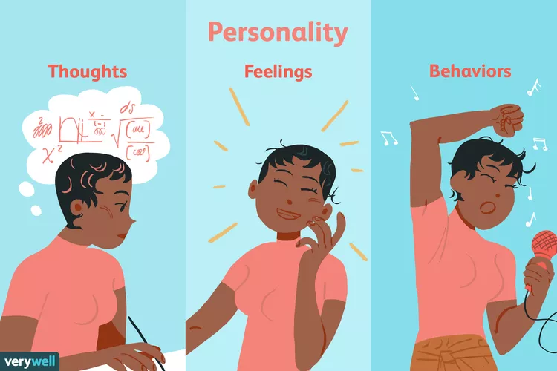
Personality
Image from www.verywellmind.com

Slide 5
What is Personality?
Personality describes the unique patterns of thoughts, feelings, and behaviors that distinguish a person from others.
Traits are the specific qualities or attributes that make up an individual's personality. They can include tendencies towards certain behaviors, emotions, attitudes, and thoughts.

Slide 6
Origin of the word “Personality”?
The word “personality” comes from the Latin word persona (puh·soh·nuh).
which refers to a theatrical masks worn by actors in ancient theater to denote different roles or characters they were playing.

Slide 7
Personality Analysis

Slide 8
Personality Analysis
Personality analysis is the systematic study and evaluation of an individual's unique traits, behaviors, and characteristics to understand their distinctive patterns of thinking, feeling, and acting.
Personality analysis can tell what personality does an individual have.

Slide 9
Personality Analysis
Like there are differenty theories to classify different types of personalities.

Slide 10
Different theories to classify different kinds of personalities

Slide 11
Myers-Briggs Type Indicator (MBTI)
Social-Cognitive Theory
Big Five Personality Traits
Type A and Type B Personalities
Psychodynamic Theory
Trait Theory
Humanistic Theory

Slide 12
Myers-Briggs Type Indicator (MBTI)
The Myers-Briggs Type Indicator (MBTI) is a popular psychometric tool used to assess and categorize people based on their preferences in how they perceive the world and make decisions.
Developed by Katharine Cook Briggs and her daughter Isabel Briggs Myers during World War II

Slide 13
Judging (J)
vs.
Perceiving (P)
Extraversion (E) vs.
Introversion (I)
MBTI
Thinking (T)
vs.
Feeling (F)
Sensing (S) vs.
Intuition (N)
Total personalities: 16

Slide 14
Extraversion (E) vs. Introversion (I)
This dichotomies refers to how people drive energy.
Extraversion(E) : ESTJ
These people gets enrgy from been around other people.
Interoversion(I) : ISTJ
These people gets energy from been alone.

Slide 15
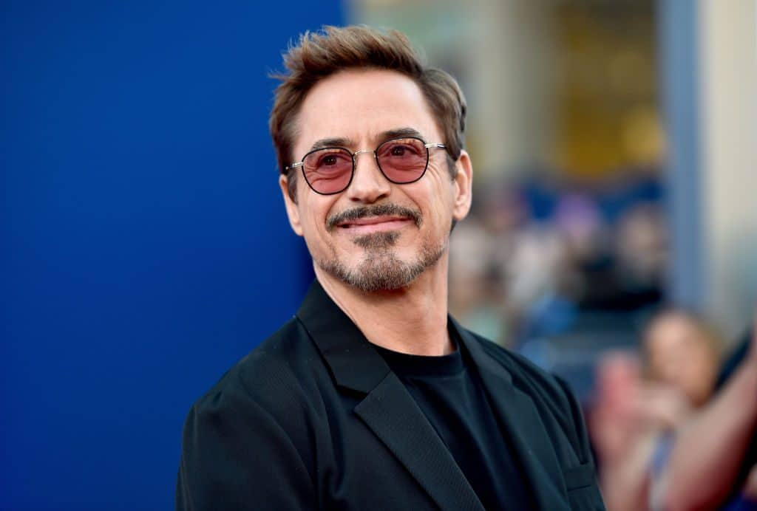
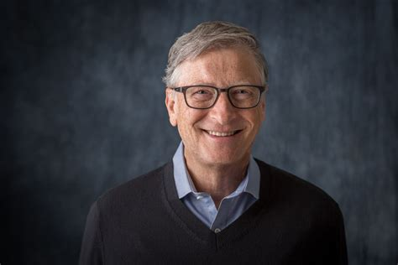
Extraversion (E)
Robert-Downey-Jr
Robert Downey Jr., known for his charismatic and energetic portrayals on-screen, embodies extraversion both in his roles and public persona.
Introversion (I)
Bill Gates
Often described as introverted, he is known for his deep focus on technology and philanthropy, preferring quieter settings to work and think.

Slide 16
Sensing (S) vs. Intuition (N)
This looks at how people view the world around them.
Sensing (S) : ESTJ
They are practical.
Concret facts
Details
Logic
Intuition (N) : ISTJ
They focus on the big picture rather than specific details.
Patterns
Connections
Future possibilities

Slide 17
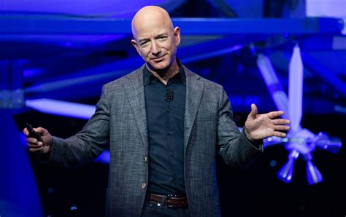
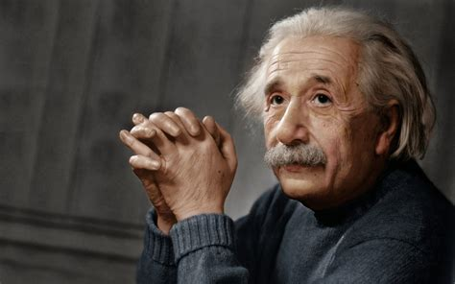
Sensing (S)
Jeff Bezos
known for his practical and detail-oriented mindset, transformed e-commerce with Amazon by focusing on efficiency and growth strategies.
Intuition (N)
Albert Einstein (INTP) -
Theoretical physicist, known for his revolutionary theories and abstract thinking.

Slide 18
Thinking (T) vs. Feeling (F)
This component looks at how people make decisions.
Thinking (T) : ESTJ
Justice
Fairness
Consistency
Feeling (F) : ESFJ
Harmony
Empathy
Compassion

Slide 19
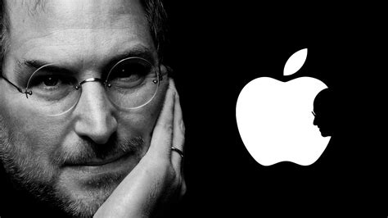
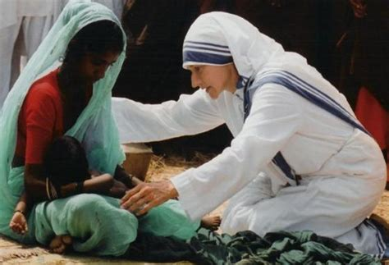
Thinking (T)
Steve Jobs (ENTJ)
Co-founder of Apple Inc., known for his visionary thinking and emphasis on logical decision-making.
Feeling (F)
Mother Teresa (ISFJ)
exemplified deep empathy and compassion in her selfless dedication to serving the poorest of the poor, embodying the essence of humanitarianism and love for others.

Slide 20
Judging (J) vs. Perceiving (P)
This component looks at how people make decisions.
Judging (J) : ESTJ
Planned
Organized
Focused on goals
work first-play later
Perceiving (P) : ISFP
Flexible
They have options open
They view deadlines as elastic

Slide 21
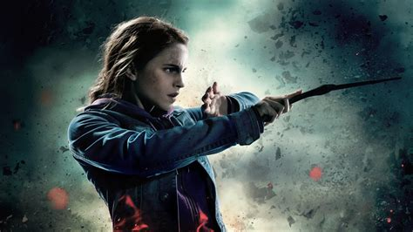
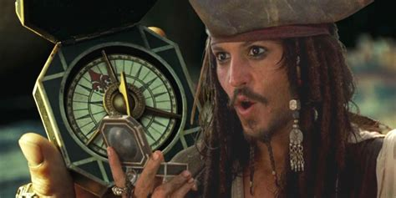
Judging (J)
Hermione Granger (INTJ)
from the Harry Potter series - Known for her intelligence, organization, and preference for structure and planning.
Perceiving (P)
Jack Sparrow (ESFP)
from the Pirates of the Caribbean series - Embraces spontaneity, flexibility, and adaptability in navigating adventures.

Slide 22
Most rare personality: INFJ (1.5%)
Most common personality: ISFJ (14%)

Slide 23

Divergent (2014)
Abnegation: Known for their selflessness and dedication to serving others.
Amity: Valuing peace, kindness, and harmony.
Candor: Emphasizing honesty and straightforwardness.
Dauntless: Known for bravery, courage, and fearlessness.
Erudite: Valuing knowledge, intelligence, and critical thinking.

Slide 24
Thank you!
Presentation by Adarsh Kumar

